Slide 1



EMBRACE YOUR PAST EXPERIENCES AS STEPPING STONES TO YOUR FUTURE SUCCESS

Slide 2
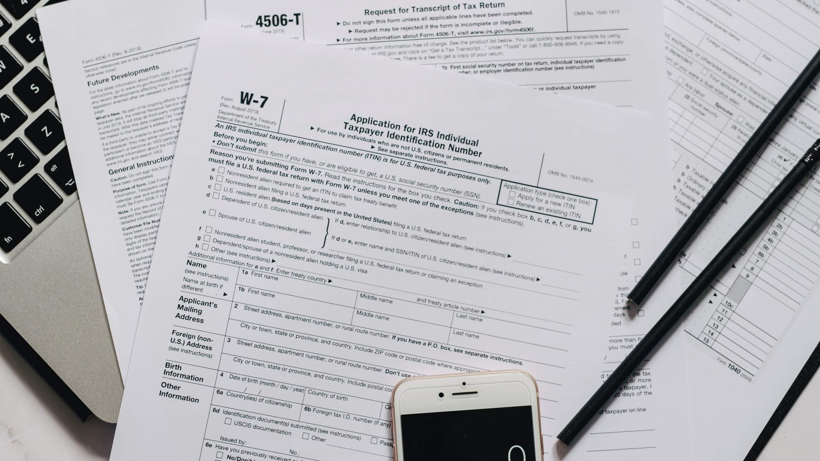
What is APEL.A?
A systematic process that involves the identification, documentation and assessment of prior experiential learning to determine the extent to which an individual has achieved the desired learning outcomes, for access to a programme of study and/or award of credits

Slide 3
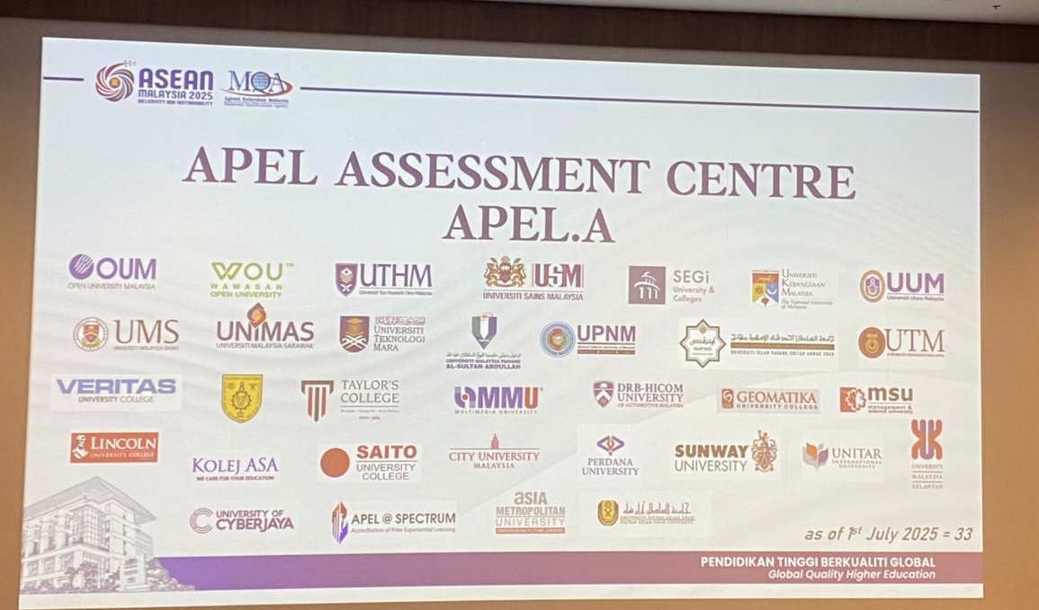
What is AAC APEL?
APEL Assessment Centre (AAC) or Pusat Penilaian APEL (PPA) refers to a Higher Education Provider (HEP) appointed by the Malaysian Qualifications Agency (MQA) to receive, assess, and process applications under APEL.A (Accreditation of Prior Experiential Learning for Access).
There are two categories of AAC/PPA namely PPA Terbuka and PPA Dalaman, as designated by the MQA.
LUC is classified as a PPA DALAMAN. Please refer to the MQA APEL portal (https://www2.mqa.gov.my/portalapela/) for more information regarding AAC.

Slide 4
Who is eligible for APEL.A?

Slide 5

Target Group for APEL.A
Individuals with work experience but lack formal academic qualifications to pursue studies at HEP
Malaysian citizens and expatriates (including family members) seeking recognition for their prior learning.
APEL is used for admission to programmes of study (gain entry to tertiary education)
APEL does not guarantee automatic admission (Applicants must still fulfill the requirements by the HEP).

Slide 6
Differences Between APEL.A and APEL.C
ACADEMIC QUALIFICATION
Conventional formal learning track
Module...n
Module...n
Conventional formal learning track with APEL.C
Module 5
Module 3
Module 4
Module 2
Module 3
Module 1
Module 2
APEL. C:
up to 30% credits in the programmes
Module 1
APEL. A
APEL. C
Using prior experiential learning to gain entry into formal
academic programmes.
Malaysian citizens with work experience, but lack formal
academic qualifications can apple APEL. A for admission into LUC.
The award of credits for prior experiential learning towards a course in an accredited programme for registered students (Local & International).
The prior experiential learning will be assessed for credit
recognition by the faculties.

Slide 7

Eligibility for APEL.A (Admission)
Bachelor
>21years old above Possess relevant work
experience/Prior Experiential Learning +Pass APEL Assessment

Slide 8

Eligibility for APEL.A (Admission)
Master
>30 years old above
STPM/Diploma/A-Level & Equivalent
Possess relevant work experience
/Prior Experiential Learning +Pass
APEL Assessment

Slide 9
APEL.A Application Process

Slide 10
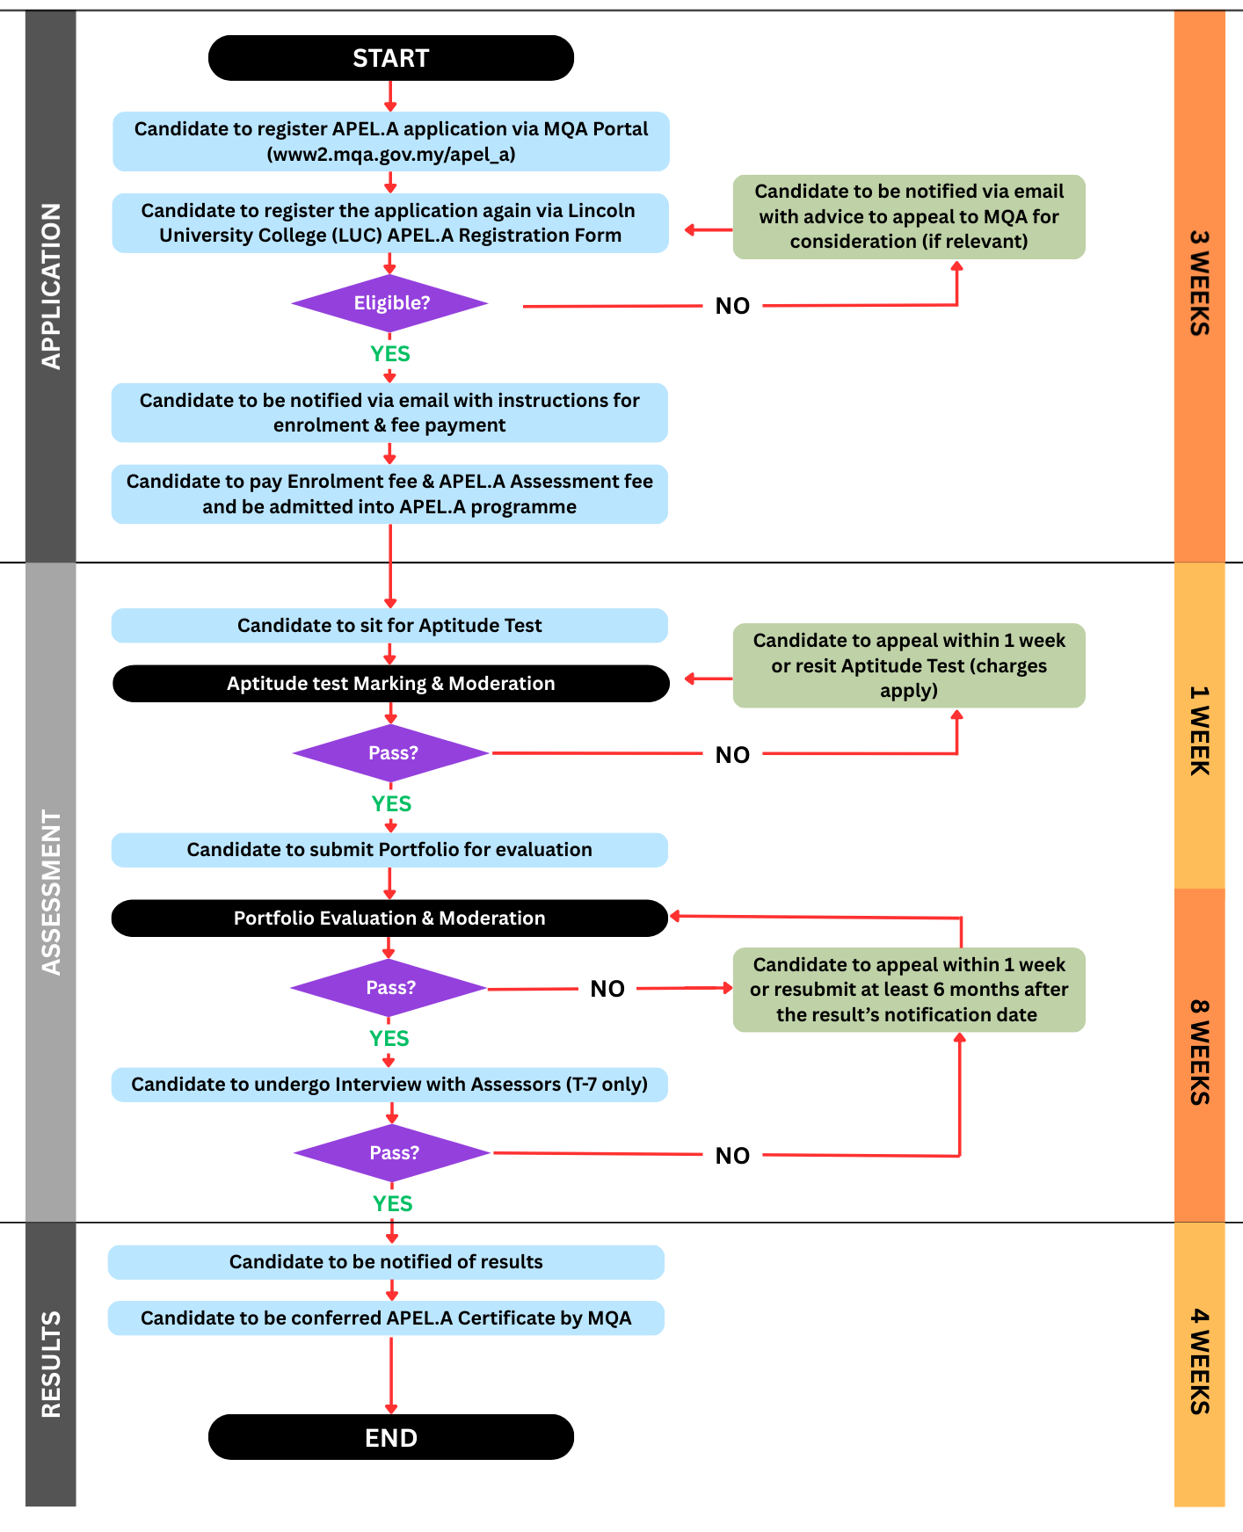
APEL.A Application Process for APEL.A T-6 and APEL.A T-7

Slide 11
APEL.A Assessment

Slide 12

The APEL.A
assessment comprises of the following:
Aptitude Test
Portfolio
Interview (only for T7
(Master’s) level )

Slide 13

Aptitude Test
The purpose of the Aptitude Test, as part of the APEL assessment, is to cater for Malay Language Literacy (for Malaysian’s candidate), English Language Literacy, Numerical Literacy and General Knowledge, Critical Thinking & Digital Literacy of the candidate.

Slide 14




Structure of Aptitude Test (T-6 & T-7)
Numerical
Literacy
Malay Language Literacy
English Language Literacy
General Knowledge, Critical Thinking & Digital Literacy
*All questions included in the T6 Aptitude Test are exclusively objective in format.
**The T7 Aptitude Test comprises objective questions in addition to five structured questions.

Slide 15


Portfolio Submission
Portfolio will help assessors to visualise and evaluate competences acquired by the candidate either through informal or non- formal learning.
Other forms of assessment shall be carried out in the form of interviews, presentations, demonstrations if the committee is uncertain with the evidence presented in the portfolio.

Slide 16
Evidence submitted can be in these forms:
CERTIFICATE
School certificates, Statements of results, Short Courses completed at work
WORK SAMPLES
02 Drawings, photographs, reports, written materials, projects, objects, work of arts
E-MAIL
Work activities, Written ski ls, Customer feedback
SUPPORTING LETTERS
Employers, Community groups, People you have worked with (paid and unpaid work)
DOCUMENTS
07 Media articles, Meritorious awards
01
05
06
RECORDS OF WORK
PLACE ACTIVITIES
Notes, emails, contracts, completed worksheets, workplace agreement
WRITTEN RECORDS
04 Diaries, records, journals, articles
03

Slide 17

Interview
T7 candidates (who have passed the Aptitude Test and Portfolio components), will be contacted for the Interview Session (the final assessment component).

Slide 18
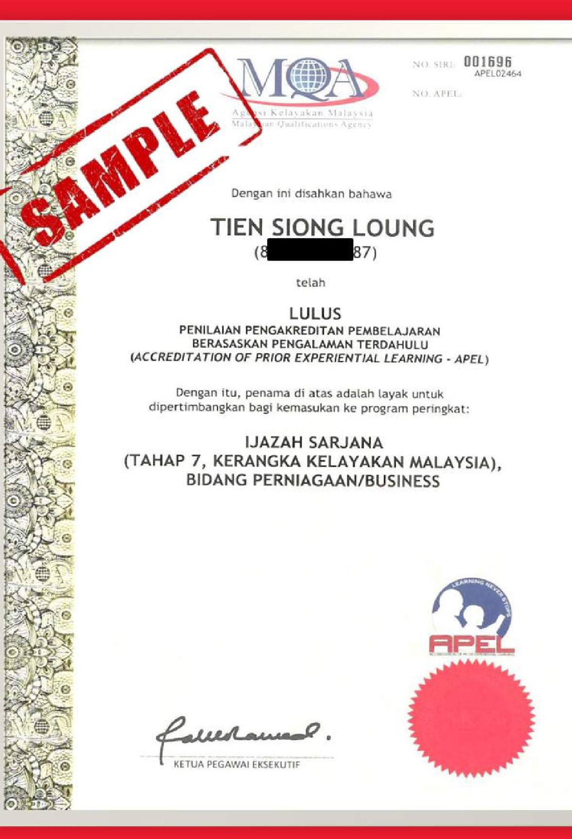
Sample of APEL.A
Certificate
The APEL.A certificate will be issued by MQA once candidates have passed all the assessments.

Slide 19
Prior Learning Assessment Centre (PLACe)
LUC A P E L.A Unit
HOW DO I FIND OUT MORE ABOUT APEL.A?
03 - 7806 3478
apel@lincoln.edu.my

